Slide 1
Hostel Management System
Course title : Software Engineering
course code : CSE - 3103
Submitted by | Submitted to
Name : SM Jubayed Hasan Hemel ID :20232086010 Name : Rukshat Shohani Mim ID :20232164010 Name : Syed Khalid Hasan Efty ID : 20232031010 Year : 3nd Semester : 1st | Name : Zahrul Jannat Peya Designation : Associate Professor

Slide 2
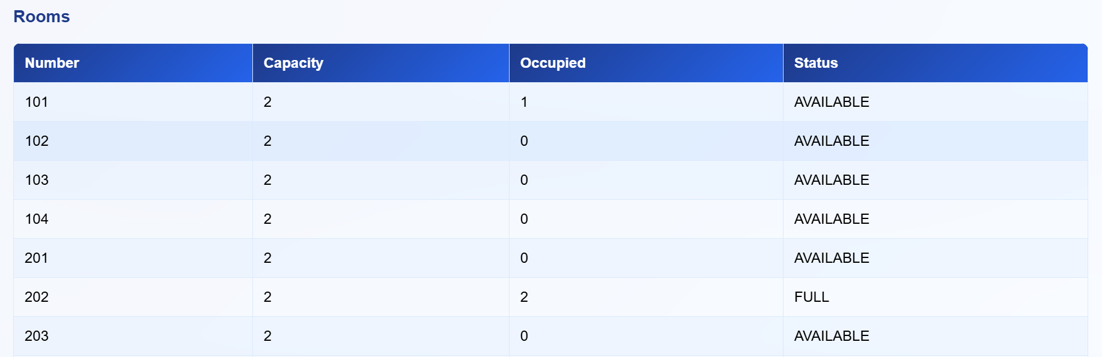
Introduction
Hostel management involves handling student accommodation efficiently.
Manual management is time-consuming and error-prone.
This project automates hostel operations — from student registration to room allocation.
It ensures accuracy, transparency, and ease of management.

Slide 3
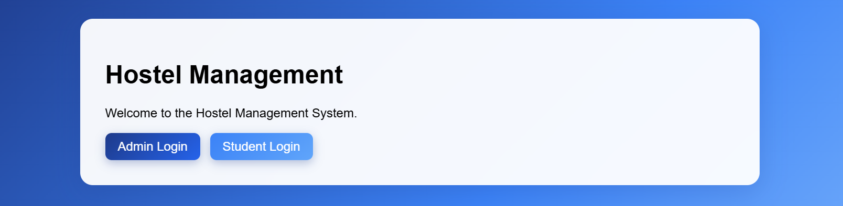
Objectives
Develop a centralized hostel management web application.
Provide login portals for Admin and Students.
Allow room booking, student registration, and record management.
Reduce paperwork and manual effort.
Enable real-time data access for both admin and students.

Slide 4
Technology Stack
Layer | Technology Used
Frontend | HTML, CSS, JSP
Backend | Java Servlets
Database | MySQL
Server | Apache Tomcat 9
Build Tool | Apache Maven
Version Control | Github
Testing | Browser-based functional testing

Slide 5
System Architecture
Browser (Client) → Servlet Controller → DAO Layer → MySQL Database
MVC Architecture used (Model–View–Controller).
Admin and Student modules interact through centralized logic.

Slide 6
Modules Overview
Main Modules:
  Admin Module
  Student Module
  Room Management
  Payment Management
  Login & Authentication
  Database Management

Slide 7
Admin Module & Student Module
Admin Module | Student Module
Add, Edit, or Delete Hostels Add Rooms and Assign to Students View and Approve Student Applications Manage Payments Generate Reports | Student Registration & Login Apply for Rooms View Room Allocation Status Update Profile Information Make Payments (if integrated) Logout Securely

Slide 8
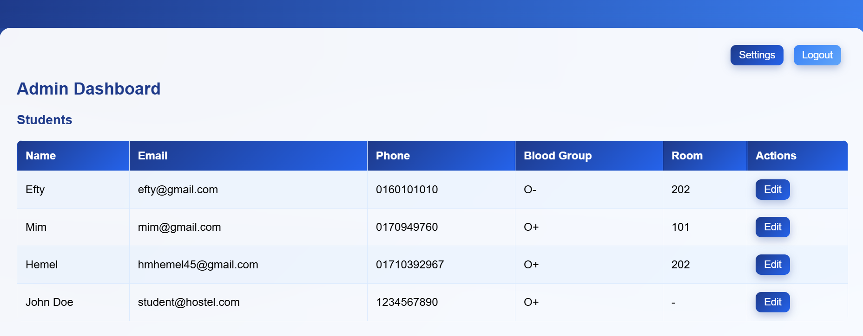

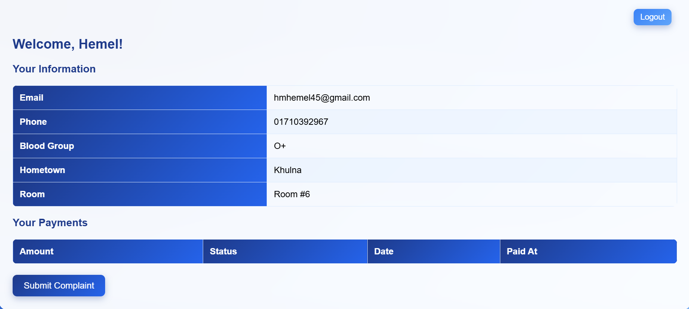

Screenshots

Slide 9
Future Enhancements
Integrate Online Payment Gateway
Add Hostel Expense Tracking
Generate Printable Reports
Send Notifications via Email/SMS
Introduce Mobile Application Support

Slide 10
Conclusion
The Hostel Management System simplifies hostel operations.
Provides a user-friendly and secure interface.
Reduces manual workload and improves record accuracy.
Enhances communication between admin and students.
Future-ready system for digital campus management.

Slide 11
Thank you everyone
Do you have any question?

